Slide 1
Trees II

Slide 2
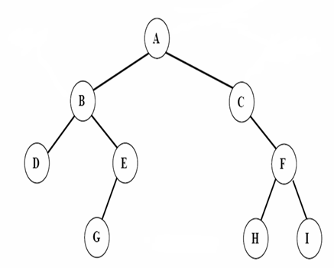
Tree Traversal
Preorder
Inorder
Postorder

Slide 3
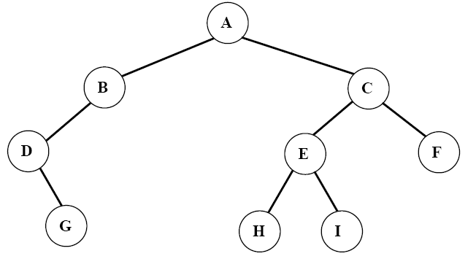
Breadth-first (level order) Traversal

Slide 4
Breadth-first (level order) Traversal

Slide 5
Breadth-first (level order) Traversal

Slide 6
Breadth-first (level order) Traversal

Slide 7
Breadth-first (level order) Traversal

Slide 8
Breadth-first (level order) Traversal

Slide 9
Breadth-first (level order) Traversal

Slide 10
Breadth-first (level order) Traversal

Slide 11
Breadth-first (level order) Traversal

Slide 12
Breadth-first (level order) Traversal

Slide 13
Breadth-first (level order) Traversal

Slide 14
void level_order(Tree ptr)
/* level order tree traversal */
{
int front= 0, rear=-1;
PtrToNode Queue[MAX_QUEUE_SIZE];
if (!ptr) return; /* empty tree */
Queue[++rear]=ptr;

Slide 15
for (;;) {
ptr = Queue[front++];
if (ptr) {
printf(“%d”, ptr->data);
if (ptr->left)
Queue[++rear]=ptr->left;
if (ptr->right)
Queue[++rear]=ptr->right;
}
else break;
}
}

Slide 16
Threaded Binary Trees
Too many null pointers in current representation of binary trees
Replace these null pointers with some useful “threads”.
T
a ⋀
n: number of nodes
number of non-null links: n-1
total links: 2n
null links: 2n-(n-1)=n+1
b
⋀ c ⋀
d
⋀ e
⋀ f ⋀
⋀ g ⋀

Slide 17
Rule 1: If PtrToNode->Left is null, replace it with a pointer to the inorder predecessor of the node
T
⋀ ⋀
T
a ⋀
Rule 2: If PtrToNode->Right is null, replace it with a pointer to the inorder successor of the node.
b
⋀ c ⋀
d
⋀ e
⋀ f ⋀
Rule 3: There must not be any loose threads. Therefore a threaded binary tree must have a head node of which the left child points to the first node.
⋀ g ⋀
Solid lines represent links
Dashed lines represent threads

Slide 18
typedef struct ThreadedTreeNode *PtrTo ThreadedNode;
typedef struct PtrToThreadedNode ThreadedTree;
typedef struct ThreadedTreeNode {
int LeftThread; /* if it is TRUE, then Left */
ThreadedTree Left; /* is a thread, not a child ptr. */
ElementType Element;
int RightThread; /* if it is TRUE, then Right */
ThreadedTree Right; /* is a thread, not a child ptr. */
}
LeftThread Left data Right RightThread
The node structure of threaded BT
0：Left is a link
LeftThread=
1：Left is a thread
0：Rchild is a link
RightThread=
1：Rchild is a thread

Slide 19

主观题
10分
Draw out the inorder threaded binary tree of the following binary tree:
正常使用主观题需2.0以上版本雨课堂
作答

Slide 20
〖Example〗 Given the syntax tree of an expression (infix)
A + B ∗ C / D
head node
+
F
F
A
/
∗
D
F
+
F
B
C
T
A
T
F
/
F
F
∗
F
T
D
T
T
B
T
T
C
T
Solid lines represent links
Dashed lines represent threads

Slide 21
Inorder Traverse Threaded BT
Find the first node:
The left most node in the tree. From the head node, following the Left link untill a node with Leftthread=1 is reached
T
H
A
B
C
p=T;
while (p->LeftThread==0 ) p=p->Left;
D
E
F
G
H
I

Slide 22
Inorder Traverse Threaded BT
Find the next node
  All the Right links of nodes with RightThread=1 are threads, point to the successor of the node
  For nodes with RightThread=0, the successor is the left most node in the right subtree of the node(i.e. search following the Left link of the right subtree untill the node with leftthread=1 reached)
T
H
A
B
C
if (p->RightThread==1) p=p->Right ;
/* find the successor with right thread*/
else /* otherwise the left most node of the
right subtree is the successor*/
{ p=p->Right ;
while (p->LeftThread==0 ) p=p->Left;
}
D
E
F
G
H
I

Slide 23
Find the first node
p=T;
while (p->LeftThread==0 ) p=p->Left;
Find the successor nodes
if (p->RightThread==1) p=p->Right ;
/* find the successor with right thread*/
else /* otherwise the left most node of the
right subtree is the successor*/
{ p=p->Right ;
while (p->LeftThread==0 ) p=p->Left;
}

Slide 24
Traverse Inorder Threaded BT
void inorder_Thread_bt(ThreadTree T)
{ PtrToThreadedNode p ;
if (T!=NULL)
{ p=T;
while (p->LeftThread==0 )
p=p->Left; /* find the left most node */
while (p!=T)
{ visit(p->data) ;
        if (p->RightThread==1)
        p=p->Right ; /* find the successor
        with right thread */
        else /* otherwise the
        left most node of the right subtree is
        the successor*/
        { p=p->Right ;
        while (p->LeftThread==0 ) p=p->Left;
        }
        }
      }
  }
T
F
F
F
+
F
T
A
T
F
/
F
F
∗
F
T
D
T
T
B
T
T
C
T

